Slide 1

RED BUS
B.Chikitha
G.Chinmai
G.Vasantha
CH.Harshini
Sriram Divyasri

Slide 2
Contents
1.About the project
2.Roles of testers in each module
3.Process of testing
4.Sprint plan
5.High level epic and user stories
6.Test scenarios
7.Requirements
8.Test cases
9.Defects
10.Traceability matrix
11.Summary report
12.Challenges faced

Slide 3
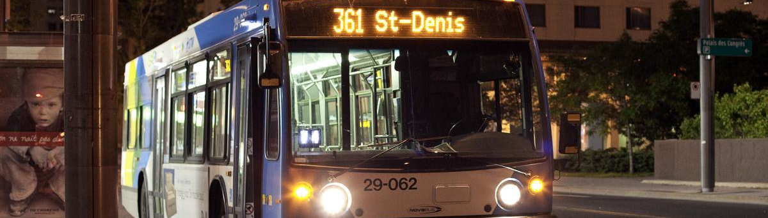
Introduction
This Photo by Unknown Author is licensed under CC BY-NC
Red Bus is an Indian online bus ticketing platform, providing ticket booking facility through its website, iOS and Android mobile apps. Headquartered in Bangalore, it connects bus travellers with a network of more than 2000 bus operators, across India, Malaysia, Indonesia, Singapore, Peru and Colombia. It claims to have registered over 180 million trips, with a customer base of over 20 million. In 2018, the company achieved a GMV of ₹50 billion (equivalent to ₹57 billion or US$750 million in 2020), with a 70% share in the Indian online bus ticketing segment.

Slide 4
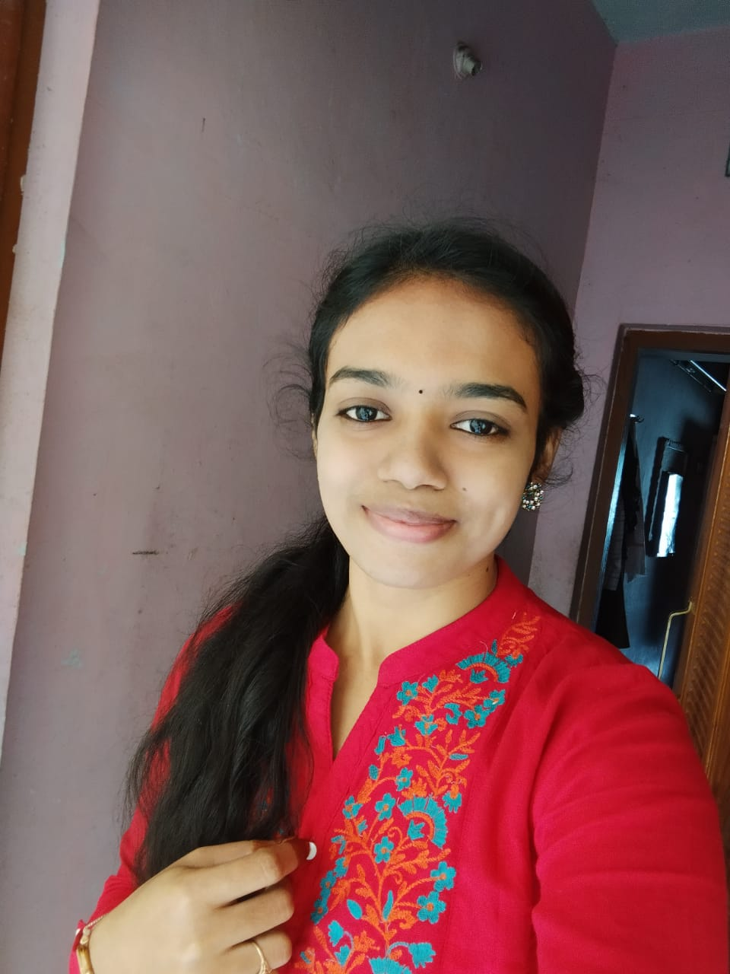
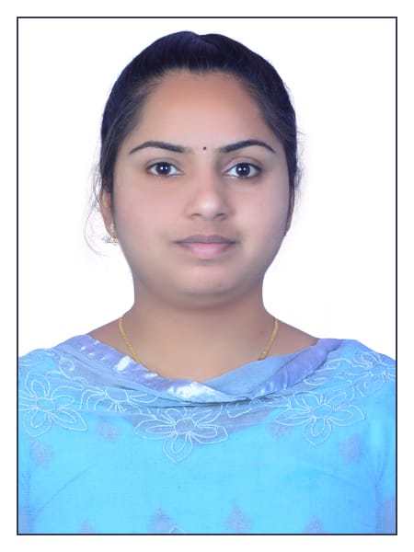
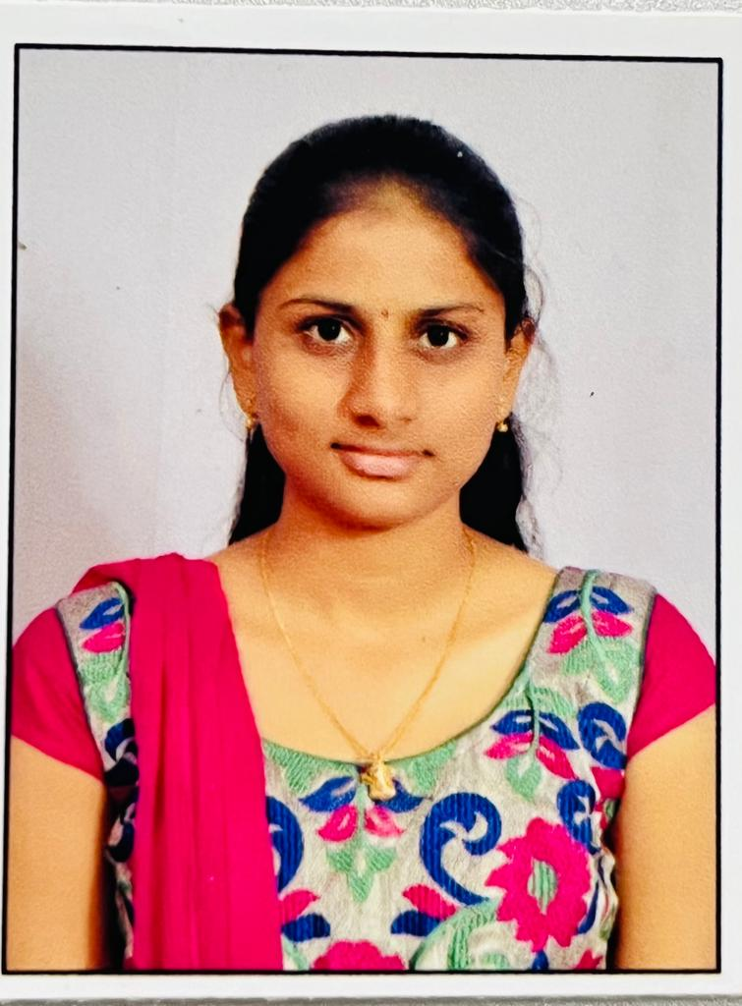
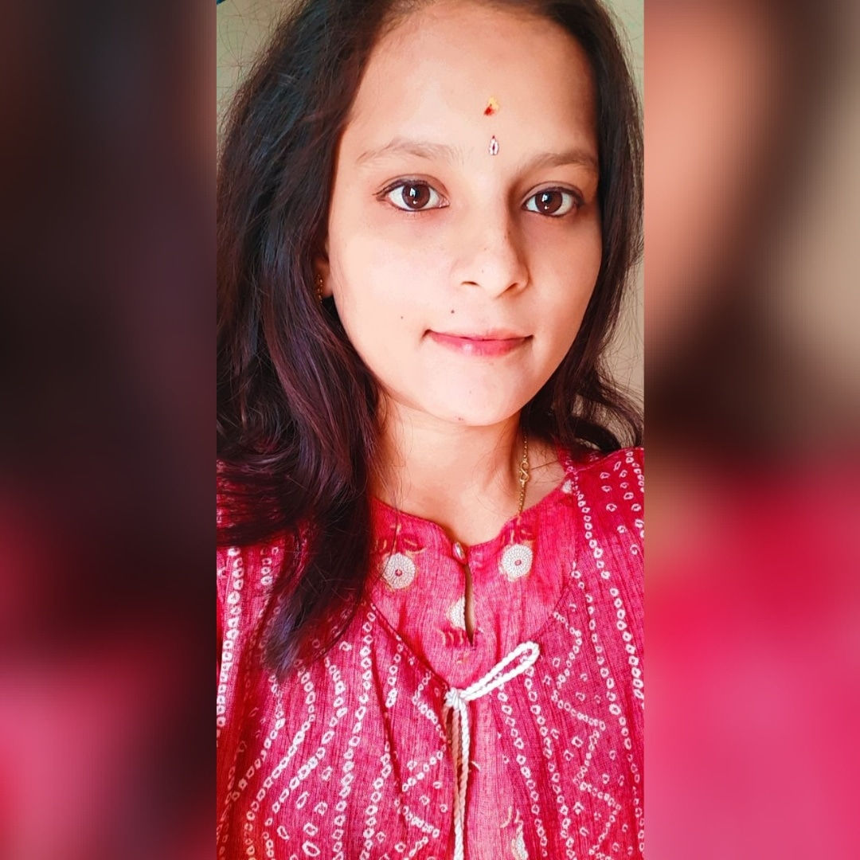

ROLES
G. Chinmai
Role: Login functionality, forgot password functionality
B.Chikitha
Role: JIRA Registration and URL functionality
G. Vasantha
Role: Search functionality, Bus availability functionality
Sriram Divyasri
Role: Booking functionality, seat available functionality
CH. Harshini
Role: Bus tracking functionality, view ticket functionality

Slide 5
Process of testing
Creating
Creating JIRA
Writing
Writing Epics
Writing
Writing User stories
Writing
Writing Test scenarios
Writing
Writing Test cases
Executing
Executing Test cases

Slide 6
Sprint plan
Executing Test cases in JIRA
We have updated every issue status into InProgress and done.
After that reports get generated
We have created the Defect report using the Test cases
Then we have prepared the Traceability matrix
Then test summary report
End of the Sprint

Slide 7
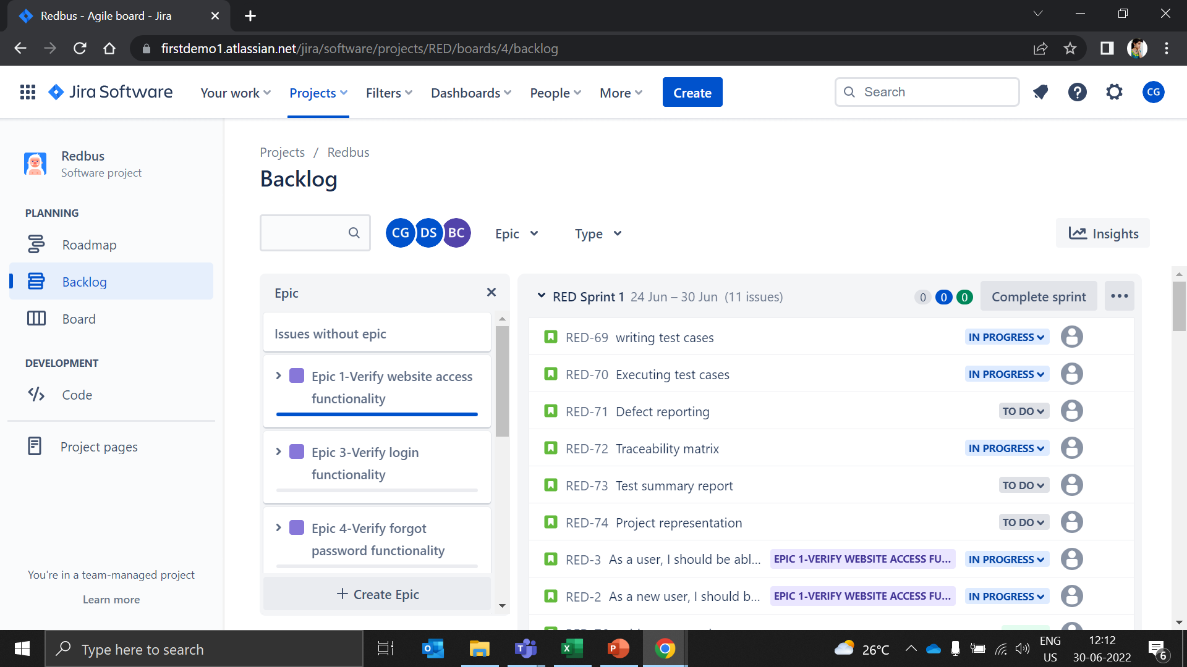
Epics and User Stories in JIRA

Slide 8
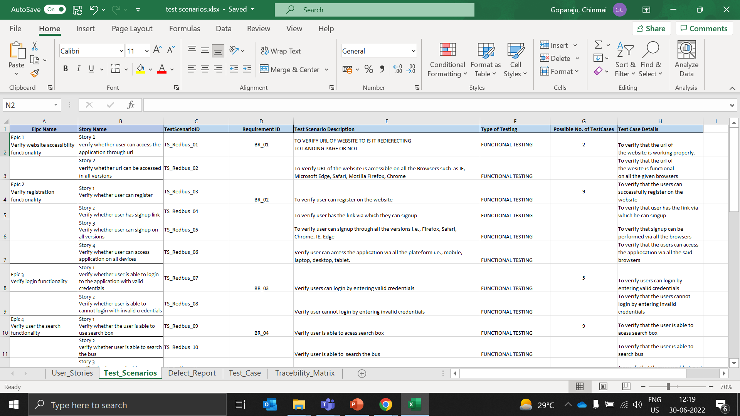
Test Scenarios

Slide 9
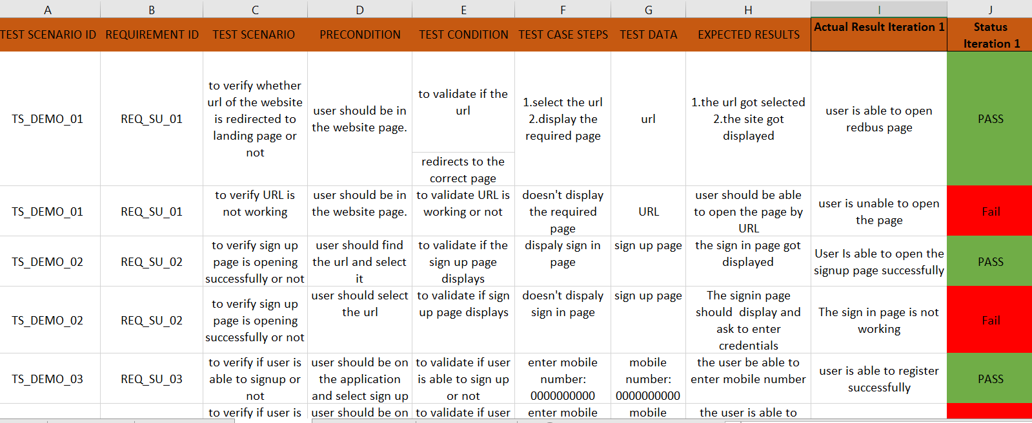
Test cases

Slide 10
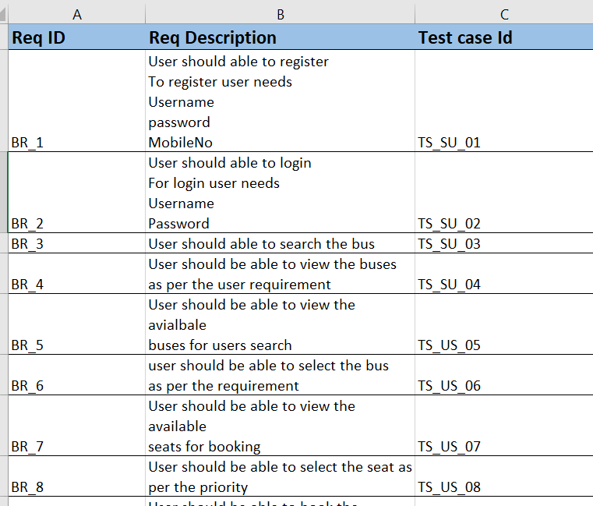
Requirement

Slide 11
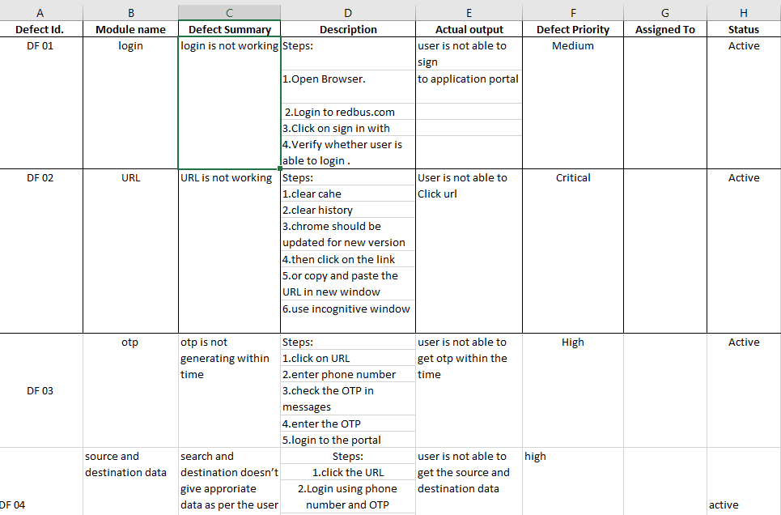
Defects

Slide 12
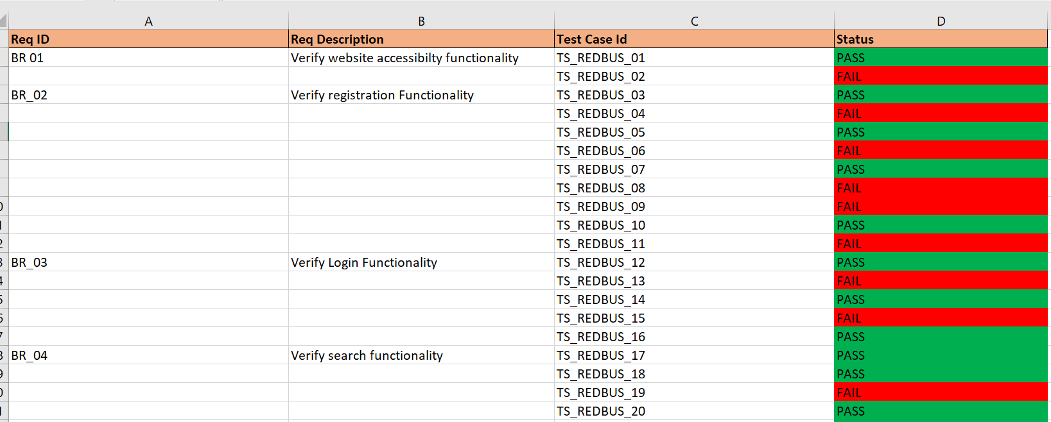
Traceability Matrix

Slide 13
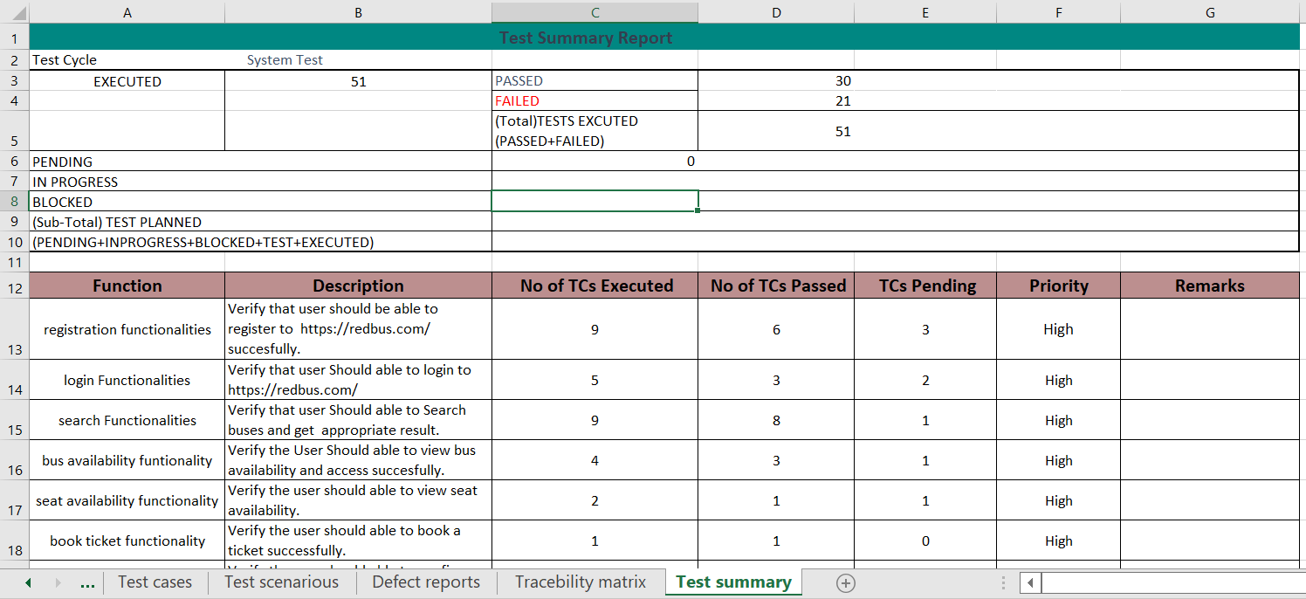
Summary Report

Slide 14
Challenges Faced
It was little challenging to handle JIRA in the earlier phase.
It was little challenging to handle excel sheets while merging because each one of us had prepared in different sheets.
Initially we had created and ended the sprint on the same day ,so from this mistake we had learnt not to End the sprint with out knowing the instructions.
We were bit worried about the 50 test cases creation, But we came to know that it was pretty easy while creating by diving modules each.
Unity among our teammates made us work efficiently and over come the obstacles

Slide 15

Thank you

